Slide 1
Decisions, decisions, decisions
An analysis of the external factors affecting National Collaborative Outreach Programme (NCOP) students and the impact these can have when making decisions about post-FE education
David Galloway Dom Thompson

Slide 2


Informing decision making
The SUN provides outreach activities for schools and colleges as part of Uni Connect – an Office for Students (OfS)-funded project.
The Uni Connect Programme is a national initiative that bring together universities, colleges and other local partners to offer activities, advice and information on the benefits and realities of going to university or college.
Network of south coast universities from Bournemouth to Portsmouth offering outreach activities
Notes:
DG

Slide 3
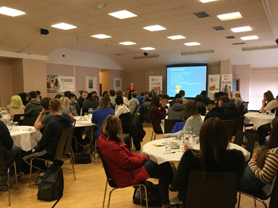
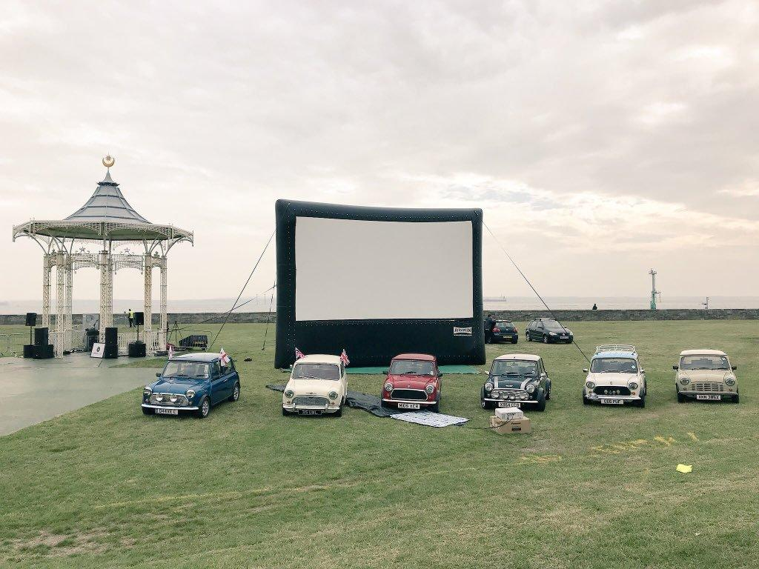
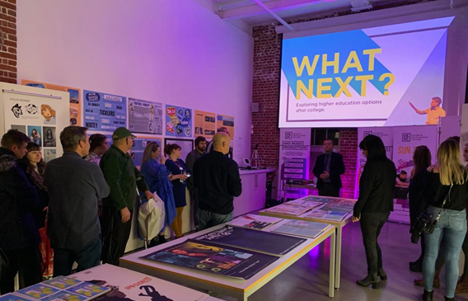
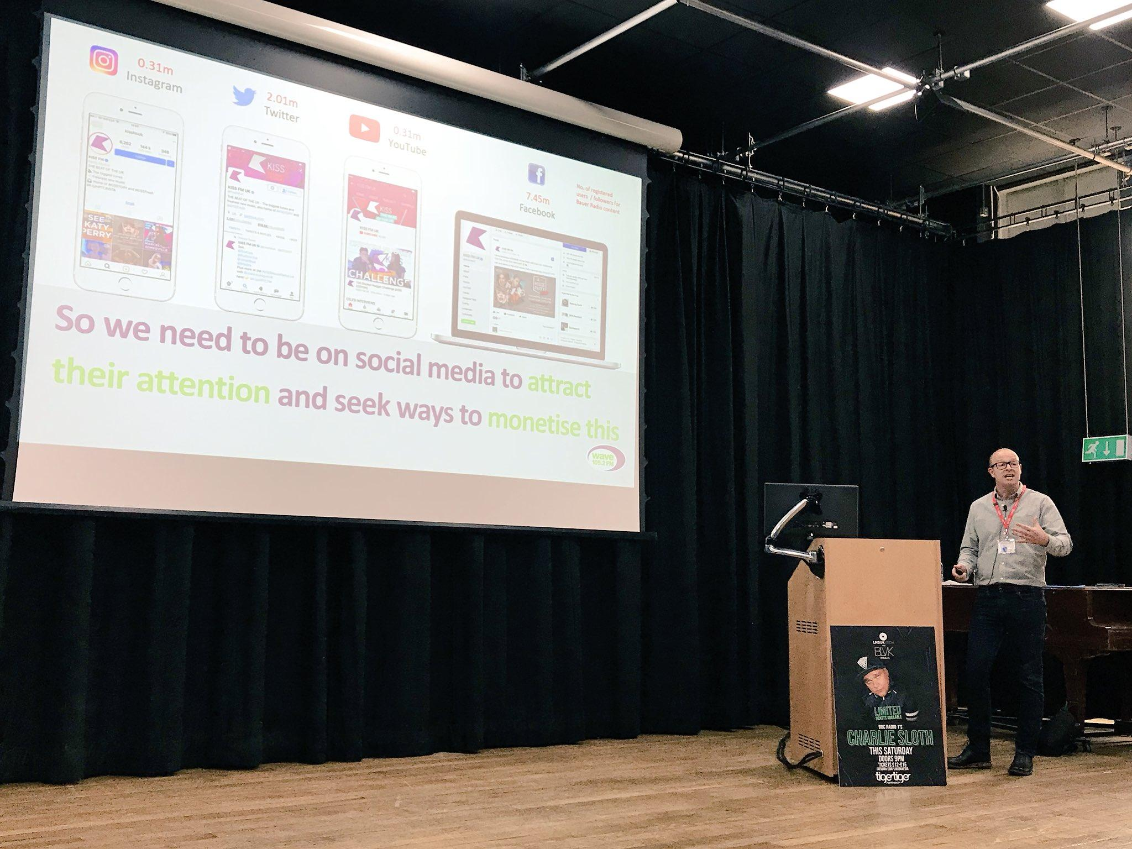
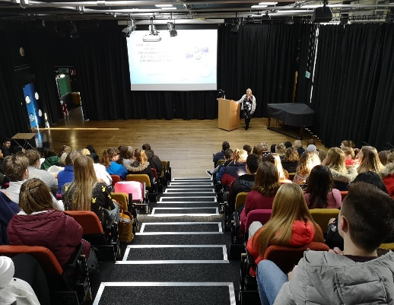
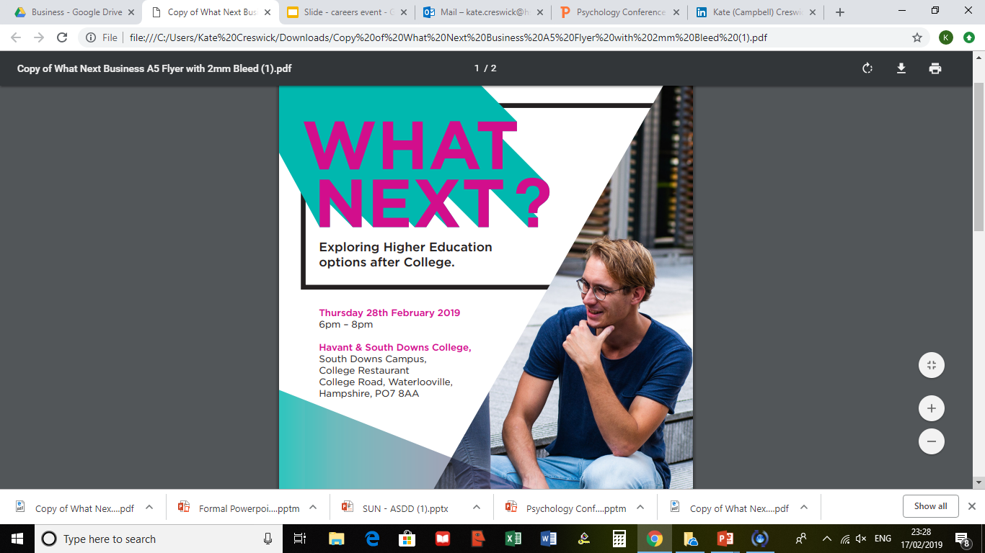






Notes:
DG

Slide 4
University as a Product
Increased impact that external forces, such as parental influence, can have on the decisions of college students (Ho & Lu, 2018).
Impact of parental expectation on student choices and the management of this (Tubin, 2015)
In 2016, nearly 90,000 students applied to university from “wealthy” areas whilst only 30,000 applied from “poorer” areas (Coughlan, 2017)
Seek to understand the demand attributes, i.e. the reasons for purchase, (Kuokkanen and Sun, 2019) specifically parents/family
Notes:
DT

Slide 5
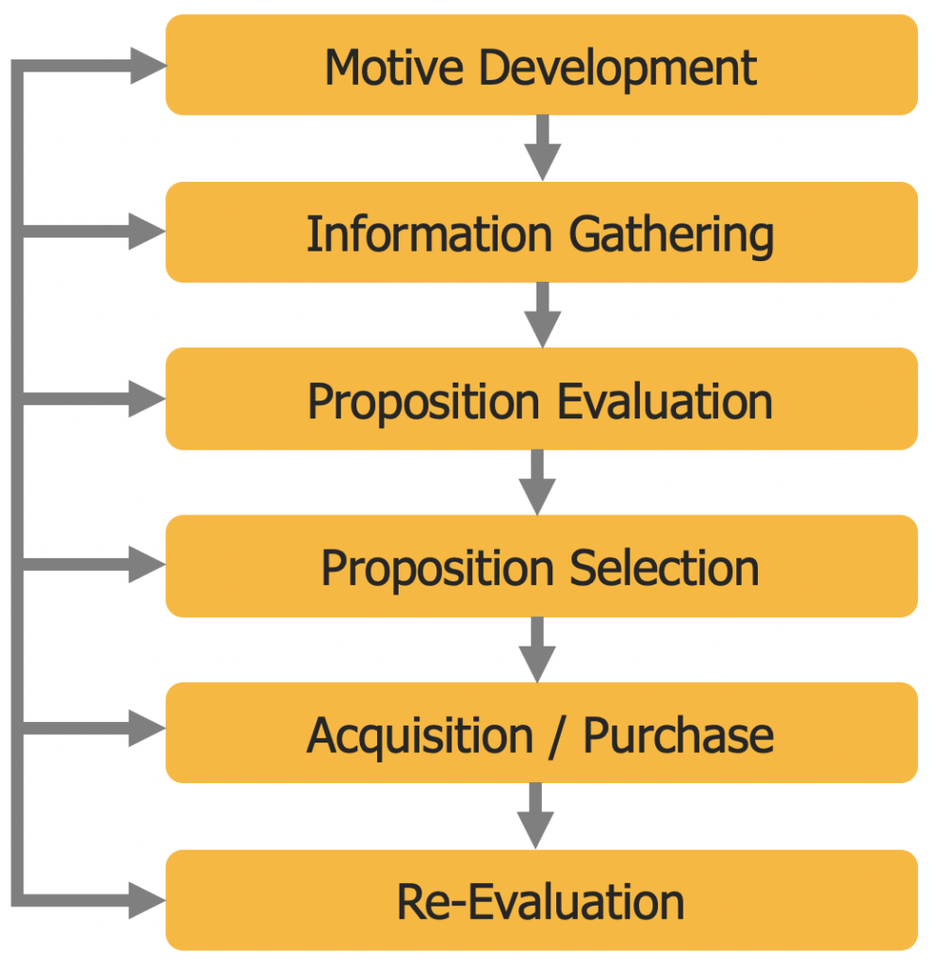
  Political
P
  Economic
E
  Social
S
  Technological
T
  Legal
L
  Environmental
E
(Baines & Fill 2013)
(Brassington & Pettitt, 2013)
Notes:
DT

Slide 6


The Research Questions & Method
1. Who do students talk to?
2. What are the main drivers behind their decisions?
3. What factors contribute to the decision making process?
4. What could be improved to enhance the decision making process?
A series of three semi-structured interviews were conducted using Google Meet. These took place regularly over the three college terms.
Notes:
DG
The research questions to be answered by this study are:
1. Who do students talk to?
2. What are the main drivers behind their decisions?
3. What factors contribute to the decision making process?
4. What could be improved to enhance the decision making process?
Method
A series of three semi-structured interviews were conducted using Google Meet. These took
place regularly over the three college terms. Eight participants who were second year
students on either a business or sport, vocational level 3 course, took part in the study.

Slide 7



Sample - Limitations - Data Analysis
8 NCOP learners, second year, vocational level 3 programmes.
Purposive - Convenience - Volunteer Sampling
Researcher bias as interviewers were part of the SUN Project team. Power dynamic between participants and researchers.
All codes developed from transcripts using NVivo 12 Plus software
Notes:
DG
Sample
The sample was selected from a combination of purposive, convenience and volunteer
sampling. That is to say the sample were NCOP learners in their second year on a vocational
level 3 programme within the subject program areas that the interviewers worked. All level
3 NCOP learners within these areas were presented with the opportunity to be involved in
the research. A total of 8 participants were recruited for the three semi structured
interviews and this sample size was selected based on volunteer sampling.
Data Analysis
A Grounded Theory approach to the analysis was utilised, with codes developed naturally
from the transcripts (Glaser & Strauss, 2017). NVivo 12 Plus software was used to facilitate
the coding and analysis of the transcripts.
To ensure a sound level of objectivity in data analysis, all information collected was
transcribed, coded and utilised to prevent any bias and misrepresentation of the data
(Cohen, Manion, and Morrison 2018).
Limitations
A potential limitation of the study was the potential for researcher bias. As the researchers
carrying out the interviews were members of the research team and linked to the SUN
project, there is potential that their perceptions and individual bias could impact the
interviews, in terms of questions used and prompts given (Cohen, Manion & Morrison,
2018).
Participation in the study may have been influenced by the power dynamic between the
participants and researchers. As the researchers who conducted the interviews work at the
college where the participants are students, this may have affected their willingness to
participate and potentially the nature of their answers (Teye, 2012).

Slide 8
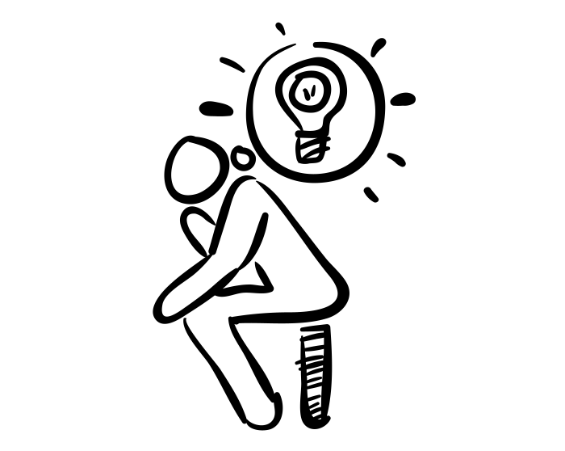
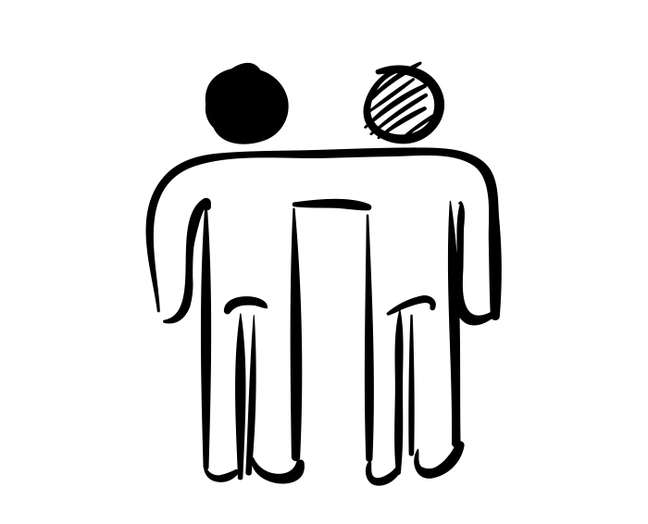

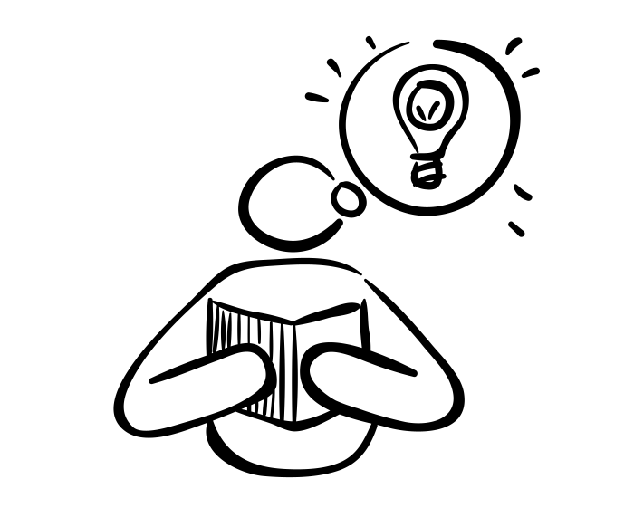
Who to talk to?
Friends
Parents
Tutor
Notes:
DT

Slide 9
Discussion - Tutors
They trust their judgement and value their perspectives due to the relationship that they have with them (Giles, 2011)
Can be a powerful cursor to a decision particularly if they have a positive perception of that member of staff (Karpouza & Emvalotis, 2019)
Services are intangible, perishable, variable and inseparable (Palmer, 2013)
...especially, my tutor, he’s been very good” …“he gives you information and then he explains positives and negatives for me and then you can work out yourself if it’s good. Like, he makes you do what’s always best for you I think is good.
... my law teacher has told me about law taster days, stuff like that, like, quite specified. But then my tutor and…they email us quite a lot about just anything general to do with uni, and we get that fed through us quite a bit, which is quite useful.
Notes:
DT

Slide 10

Discussion Parents/Friends
“...But I think the biggest conversations I’ve probably had with my mum. She wants me to go to uni, she thinks it’ll be like the best thing I’ve done. But she’s also quite a big person to, like, push me on not to do physio, go onto other courses. So I get my back up quite a bit with some conversations we’ve had.” - Hannah
“So I have in mind to go to Chichester because...the main reason, I know it’s maybe not a good idea, but a few of my mates from my course and college right now are going there and I didn’t want to be alone. But then again, I chose Winchester out of the fact that I need to do what’s best for myself. But I know the courses my friends are attending in Chichester, they’re not attending the same course. They’re attending sports therapy, not strength and conditioning, which is kind of a separate area to me.” - Adam
Friends as sounding boards
Parents as listeners, coaches & influencers
Notes:
DT
Key finding:
The key finding was that participants received support in their decision making from
a variety of people in their lives including their friends, parents, but also did their
own research.
Recommendation
Parents also have a significant influence over the decision making of their children
and universities should engage with this group to ensure accurate and current
information is available for them to help inform decisions.
The role of the parent appears to be dependent on the participants’ relationship with their
parents and the way that advice was perceived to be intended. Parents who acted as
influencers, listeners, and coaches more strongly influenced their children’s decisions than
parents who were more demanding with certainty in their ideas for their children’s futures.
While the participants expressed the importance of friends discuss their futures with,
ultimately, the decision about their next steps was not one that was ultimately strongly
influenced by their friends. - Friends as sounding boards and motivators to make decisions.

Slide 11
Recommendations
Universities should engage more with college tutors to update them with details of the university itself, the benefits and specific courses.
  Webinars
  Events
Parents also have a significant influence over the decision making of their children and universities should engage more with this group to ensure accurate and current information is available for them to help inform decisions.
  Webinars
  Events
Tutor
Parents
Notes:
DT

Slide 12
References
Ageeva, E., Melewar, T. C., Foroudi, P., & Dennis, C. (2019). Evaluating the factors of corporate website favorability: a case of UK and Russia. Qualitative Market Research: An International Journal, 22(5), 687–715. https://doi.org/10.1108/QMR-09-2017-0122
Baines, P., Fill, C., & Page, K. (2013). Essentials of Marketing. Oxford University Press.
Berry, L. (2016). The Research Relationship in Narrative Enquiry. Nurse Researcher, 24(1), 10-14. doi:10.7748/nr.2016.e1430
Brassington, F & Pettitt, S. (201307). Principles of Marketing (3rd ed.). Pearson Education Limited.
Choak, C. (2012). Asking questions: Interviews and evaluations. In S. Bradford, & F. Cullen, Research and research methods for youth practitioners (pp. 90–112). Routledge.
Cohen, L., Manion, L., & Morrison, K. (2018). Research Methods in Education (8th ed.). Routledge.
Connelly, F. M., & Clandinin, D. J. (1990). Stories of Experience and Narrative Inquiry. Educational Researcher, 19(5), 2-14. https://doi.org/10.3102/0013189X019005002
Coughlan, S. (2017) Students say University “value for money” falling, BBC News, https://www.bbc.co.uk/news/education-40187297
Fatima, K., Bawany, N. Z., & Bukhari, M. (2020). Usability and Accessibility Evaluation of Banking Websites. 2020 International Conference on Advanced Computer Science and Information Systems (ICACSIS), Advanced Computer Science and Information Systems (ICACSIS), 2020 International Conference On, 247–256. https://doi.org/10.1109/ICACSIS51025.2020.9263083
Flick, U. W. E. (2009). An introduction to qualitative research. SAGE Publishing.
Giles, D. (2011). Relationships Always Matter: Findings from a Phenomenological Research Inquiry. Australian Journal of Teacher Education, 36(6), 80-91. http://dx.doi.org/10.14221/ajte.2011v36n6.1
Glaser, B. G., & Strauss, A. L. (2017). Discovery of grounded theory: strategies for qualitative research. Routledge.
Gubrium, J.F., Holstein, J.A., Marvasti, A.B., & McKinney, K.D. (2012). The SAGE Handbook of Interview Research: The Complexity of the Craft (2nd ed.). SAGE Publications, Inc.
Ho, C. S. M, & Lu, J. (2019). School competition in Hong Kong: A battle of lifting school academic performance? International Journal of Educational Management, 33(7), 1483-1500. doi: 10.1108/IJEM-07-2018-0201

Slide 13
Karpouza, E., & Emvalotis, A. (2019). Exploring the teacher-student relationship in graduate education: a constructivist grounded theory. Teaching in Higher Education, 24(2), 121–140. https://doi.org/10.1080/13562517.2018.1468319
Kim, J. (2016). Narrative data analysis and interpretation. In Kim, J. Understanding narrative inquiry (pp. 184-225). SAGE Publications. doi: 10.4135/9781071802861
Kotler, P. (2005). The Role Played by the Broadening of Marketing Movement in the History of Marketing Thought. Journal of Public Policy & Marketing, 24(1), 114–116. https://doi.org/10.1509/jppm.24.1.114.63903
Kuokkanen, H, & Sun, W.X. (2019). Companies, Meet Ethical Consumers: Strategic CSR Management to Impact Consumer Choice. Journal of Business Ethics, 166(2), 403–423. https://doi.org/10.1007/s10551-019-04145-4
Lo Iacono, V., Symonds, P., & Brown, D. H. K. (2016). Skype as a Tool for Qualitative Research Interviews. Sociological Research Online, 21(2). https://doi.org/10.5153/sro.3952
Manzoor, M., Hussain, W., Ahmed, A., & Iqbal, M. J. (2012). The importance of higher education website and its usability. International Journal of Basic and Applied Sciences, 1(2), 150-163.
Oppenheim, L. (1992). The First Interview in Child Protection: Social Work Method and Process. Journal of Children and Society, 6(2), 132-150. https://doi.org/10.1111/j.1099-0860.1992.tb00393.x
Palmer, A. & Koenig‐Lewis, N. (2009). An experiential, social network‐based approach to direct marketing. Direct Marketing: An International Journal, 3(3), 162 - 176. https://doi.org/10.1108/17505930910985116
Palmer, A. (2013).Principles of Services Marketing. McGraw Hill.
Prensky, M. (2005). Listen to the natives. Educational leadership, 63(4), 8 -13.
Rogers, E. (2003). Diffusion of Innovations (5th ed.). Simon and Schuster.
Rubin, H., & Rubin, I. (2005). Qualitative interviewing: The art of hearing data. SAGE Publishing.
Ryan, G. (1999). Measuring the typicality of text: Using multiple coders for more than just reliability and validity checks. Human Organization, 58(3), 313-322. https://doi.org/10.17730/humo.58.3.g224147522545rln
Schmutz, S., Sonderegger, A., & Sauer, J. (2018.). Effects of accessible website design on nondisabled users: age and device as moderating factors. Ergonomics, 61(5), 697–709. https://doi.org/10.1080/00140139.2017.1405080
Spence, D. P. (1986). Narrative smoothing and clinical wisdom. In T. R. Sarbin (Ed.), Narrative psychology: The storied nature of human conduct (pp. 211–232). Praeger Publishers/Greenwood Publishing Group.
Teye, J. (2012). Benefits, Challenges, and Dynamism of Positionalities Associated With Mixed Methods Research in Developing Countries: Evidence From Ghana. Journal of Mixed Methods Research, 6(4), 379-391. https://doi.org/10.1177/1558689812453332.

